Slide 1
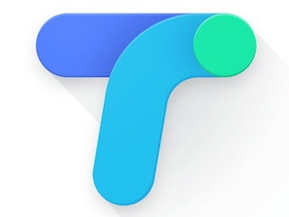
Google Tez App
Google payment app 'Tez' :

Slide 2
Google Tez App: Things You Should Know About the New Digital Payments App
Google made its foray into the burgeoning mobile payments sector in India on Monday by launching its mobile wallet app, Google Tez, at an event in New Delhi attended by Finance Minister Arun Jaitley. Here is all you need to know about the latest entrant to the digital payment marketplace.

Slide 3
How does it work?
Google Tez is a mobile wallet based on the Unified Payments Interface (UPI) platform built by the National Payments Corporation of India (NPCI). UPI-enabled wallets permit users to transfer money without requiring the bank account details of the recipient. The UPI ID of the recipient is used as a proxy for the account number and IFSC code, thereby simplifying the process of money transfer.

Slide 4
How is it different from other digital wallets?
Unlike most other wallets apps, it does not require money to be stored in the app to make digital payments. Tez works as an extension of one's bank account, which means that unused money remains in the bank earning interest. Each transaction is initiated by the sender entering his UPI pin with the additional security of existing phone locks. The app is available for download on both Android and iOS devices. This is functionally similar to the BHIM app.

Slide 5
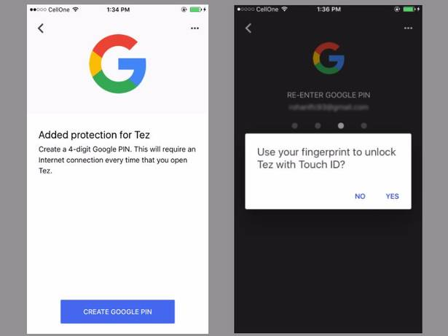
How can you transfer money using Tez?
After installing the app, users have to sync their wallets with their Google account, and the mobile number linked to it. Access to the wallet from the app drawer is protected by two-level security: a 4-digit Google PIN, and the security settings on the device, such as passcodes, fingerprints, or pattern locks.

Slide 6
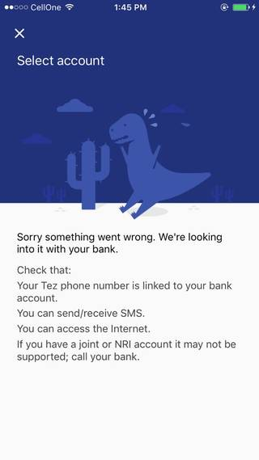
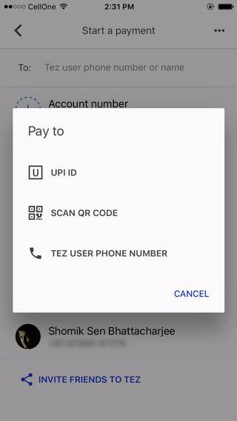
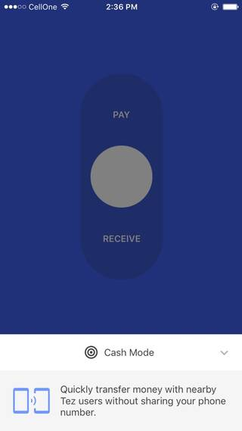

Slide 7
What are the extra benefits of using the app?
The Google Tez interface offers language support in English, Hindi, Bengali, Kannada, Tamil, Gujarati, Marathi, and Telugu. To gain greater traction among digital natives, Google has brought out an introductory offer on referrals which allows users to pocket ₹51 whenever the new user makes a transaction. A maximum of ₹9,000 can be redeemed every year. The offer is valid till April 1, 2018.

Slide 8
What is Tez for Business?
Google has got most major banks to sign up for its Tez platform, which enables businesses banking with the latter to transact using the app. Dominos, RedBus, and PVR have already joined the bandwagon in embracing Google's latest offering. The biggest incentive to other businesses to enrol for Tez is that all payments go through to the merchant's bank with minimal latency, and more importantly, without levying transaction fees.

Slide 9
How much do other mobile wallets charge as transaction fee?
For every payment worth ₹100 made by a customer to their Paytm wallet, ₹1.99 is accounted for as the transaction charge while ₹0.35 is levied as GST. The payout to the account is ultimately ₹97.66. Meanwhile, Mobikwik comes at a 'nominal' charge of 4% of the transfer amount (per transaction). The processing fee for PayUmoney, Oxigen, and Ola Money are 2.9%, 3% (wallet to bank account), and 4% respectively. PhonePe offers free money transfer for all payment modes.

Slide 10
Conclusion:
The volume of transactions has grown from ₹3.092 crore in August 2016 to ₹4127.19 crore in August 2017. The RBI is mulling granting more licences to mobile wallets after the success of the government-developed BHIM app which runs on UPI. Google's entry into the digital payments space in India will set the cat among the pigeons and force rivals who are not yet on the UPI network to rethink their strategy.

Slide 11
Thanks
Name :Anshu Kumar Shandilya
College :jis college of engineering,kalyani
Stream: Computer science and engineering

