Slide 1
SARAHAH
SECRET MESSAGE APP

Slide 2
Introduction
Sarahah is website or application which allow you to receive honestly feedback about yourself.
This app is created by Saudi Arabian developer named Zain-al-Abidin Tawfiq
This is become so much popular that it become a trend, and everyone follows it.
On august 5th,2017 this app was launched, now it has 66,194 users and having 3.2 rating star by google play store.
This app is highesty installed in the regions like Australia,Ireland,the U.S, the UK

Slide 3

WHAT IS SARAHAH
1.Sarahah is an application which can be both downloaded by Android and iOS users.
2. This app spreds like a wild fire because of it’s simplicity and anonymous functions.

Slide 4
Why sarahah app became so popular
The original vision of the app is honesty and frankness.
It was built on the premise that people are more willing to be honest when their messages are anonymized.
It is become particularly popular in Arab speaking regions.

Slide 5
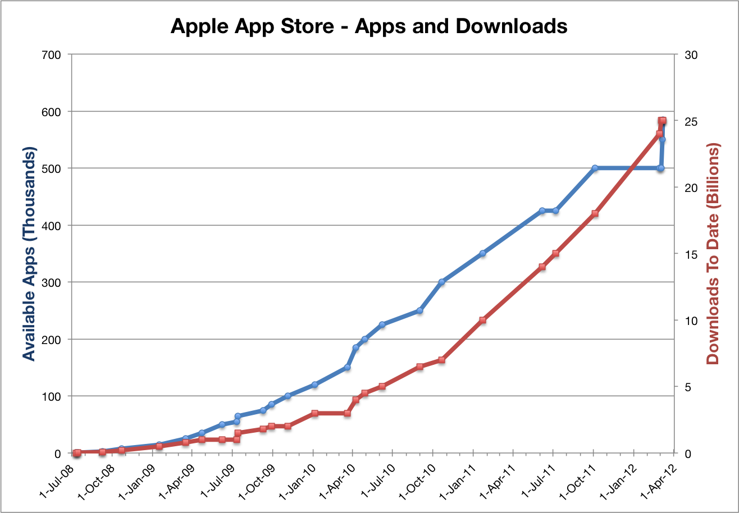
THE GRAPH>>>

Slide 6
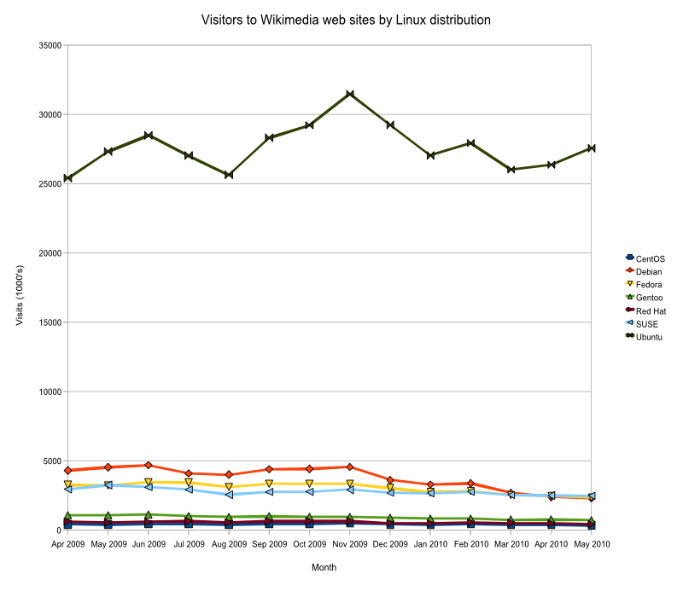
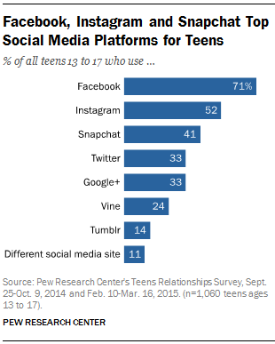
Popuarity comparison
sarahah
Snap chat

Slide 7
Disadvantages…
Sending constructive message to one another
Cyber crime
Use this app to bully the other person.
one can send any type of message by hiding his identity.
Though this sounds tempting and interesting but it is scary too..

Slide 8
THANK YOU

