Slide 1
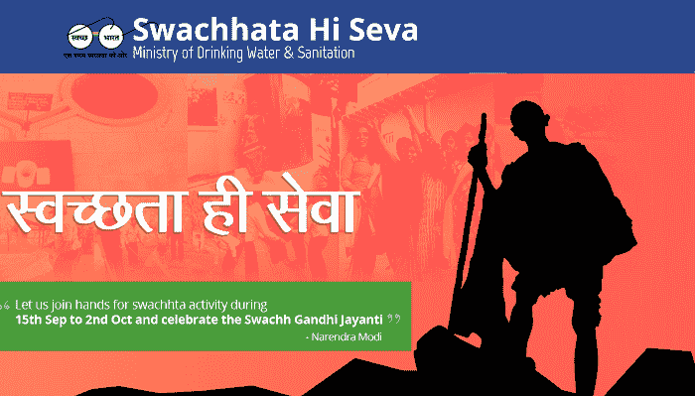
'Swachhta hi Seva' Campaign
Launched 15th September ’17 by union govt. of India

Slide 2
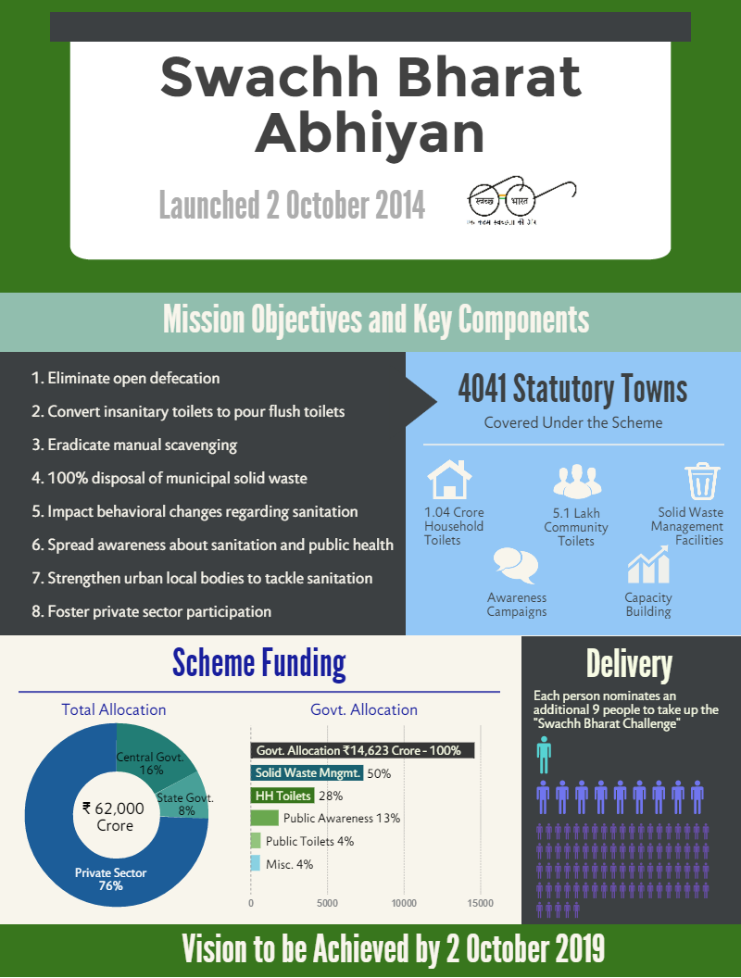
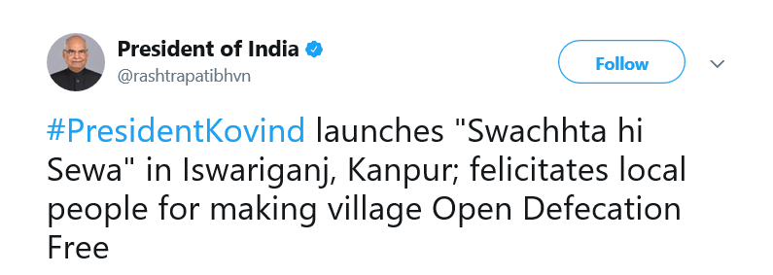
The Union Government has launched yet another campaign to make India clean.

Slide 3
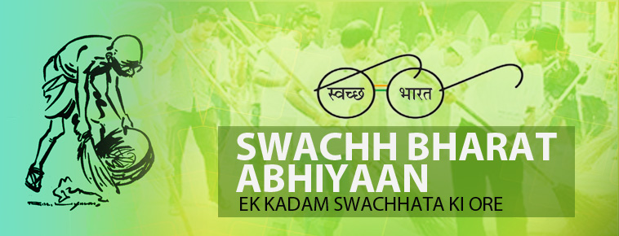
Background
Prime Minister Narendra Modi has always been very eager to see India as a clean country.
‘Swachh Bharat Abhiyan’ was launched on 2 October 2014. Its predecessors were the ‘Nirmal Bharat Abhiyan’ and before that the ‘Total Sanitation Campaign’.
Now, a follow up of the central government's ambitious cleanliness drive – The Swach Bharat Abhiyan 'Swachhta hi Seva’ Campaign has been launched.
President Ram Nath Kovind on friday kicked off the fortnight-long 'Swachhta Hi Seva' (Cleanliness is Service) campaign from Uttar Pradesh.

Slide 4
Reasons behind launching such campaigns
Currently nearly 60 percent of India's population practice open defecation which puts them at risk of diseases like cholera, diarrhoea, typhoid etc.
Not only this, India also face economic loss because of poor hygiene and sanitation in the country as a World Bank report in 2006 said that India losses 6.4 percent of GDP annually because of the aforementioned reason.
Reports say that India is a gold medalist in open defecation and nearly 60 per cent of Indian population clear their bowels in the open. This 60 percent is roughly 58% of the people who practise open defecation all over the world.
India loses at least 1000 children a day to diarrhoeal deaths and the reason for these deaths is open defecation and lack of proper sanitation facilities.
As per reports, water of river Ganga is unsafe for bathing because it contains faecal coliform bacteria (120 times higher than the permitted levels) in large amounts and again the reason is open defecation in our country.
Poor hygiene and sanitation facilities costs India 600,000 lives annually becuase of diarrhea and not only this, lack of toilets also expose one third of country's women to the risk of rape or sexual assault.
India accounts for about 60 percent of the world's residents without toilets, according to a report released in May by the World Health Organization and Unicef.
Swachh Bharat's connection with economic activity of the country : Advocating the idea of Clean india, Prime Minister Narendra Modi had said, "The pursuit of cleanliness can be an economic activity, contributing to GDP growth, reduction in healthcare costs, and a source of employment.“
If India and its tourist destinations are clean, it will bring more people and will also bring about a paradigm shift in the country's global perception.

Slide 5
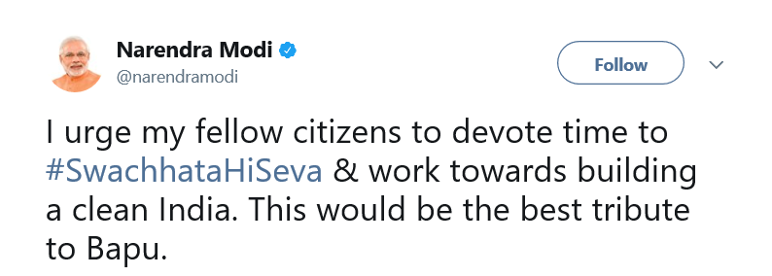
This campaign ends on 2nd October which is also the birth anniversary of the father of the nation Mahatma Gandhi.
Prime Minister Narendra Modi said in his recent public address that, this campaign is aimed to make India clean once again before Gandhi Jayanti.

Slide 6
Details of the campaign
It will be running from September 15 to October 2, 2017
The campaign is being coordinated by Union Ministry of Drinking Water and Sanitation, which is the concerned ministry managing the Swachh Bharat Mission.
The Ministry has made elaborate plans along with State Governments to involve people from various walks of life and make this an unprecedented people's campaign

Slide 7
The objectives
Its objective is to mobilise people and reinforce ‘jan aandolan’ (mass movement) for sanitation to contribute to Mahatma Gandhi's dream of a Clean India.
The campaigners will target the cleaning of public and tourist places and to make the environment open defecation free.
The campaign is aiming for large scale mobilisation of people from all walks of life to volunteer for cleanliness and construction of toilets.
One of the major part of the campaign is to reach out to the poor and marginalised and provide them with sustainable sanitation services
Clearly, the objectives of 'Swachhta hi Seva’ is same as the ‘Swachh Bharat Abhiyan’, only this time the campaign is set to be more focused and run for a shorter duration of time.

Slide 8
What this campaign will consists of?
Various programmes are being organised under the drive :
Flagging off Swachhta Express.
Special Gram Sabhas and other awareness camps regarding construction of twin pit toilet and IHHL.
Cleanliness drives, anti-polythene drives, water conservation drives, green rallies.
Walkathons for achieving ODF and award ceremony for recognizing the initiatives and efforts towards achieving various targets under ‘Swachh Bharat’.

Slide 9
The outcome
As the campaign has been just launched yesterday the outcome is uncertain…

