Slide 1
EXORSA V5.0
On Behalf of the
Purulia Government Engineering College
DEEP OCEAN MISSION
Presented by:-
ROHIT PRASAD SHAW
Dept-Civil engineering
(2016-20)
2nd Year

Slide 2
INTRODUCTION
The Union Ministry of Earth Sciences (MoES) is all set to launch ‘Deep Ocean Mission’ by January 2018, which is expected to improve India’s position in ocean research field, M Rajeevan, Secretary, MoES said here on Tuesday.
Mr. Rajeevan, who is also chairman of the Polymetallic Nodules Assessment Committee was addressing a workshop on ‘Three decades of India acquiring Pioneer Investor Status — Achievements and way forward’ at the CSIR-National Institute of Oceanography(NIO).

Slide 3
The program on poly metallic nodules was initiated at CSIR-NIO with the collection of the first nodule sample from Arabian Sea on board the first research vessel Gaveshani on January 26,1981. India was the first country in the world to have been given the pioneer area for exploration of deep-sea mineral, namely, polymetallic nodules in the Central Indian Ocean Basin in 1987.

Slide 4
In general, modern scientific Deep-sea exploration can be said to have begun when French scientist Pierre Simon de Laplaceinvestigated the average depth of the Atlantic ocean by observing tidal motions registered on Brazilian and African coasts. He calculated the depth to be 3,962 m (13,000 ft), a value later proven quite accurate by soundings measurement.^{[1]} Later on, with increasing demand for submarine cables installment, accurate soundings was required and the first investigations of the sea bottom were undertaken. First deep-sea life forms were discovered in 1864 when Norwegian researchers obtained a sample of a stalked crinoid at a depth of 3,109 m (10,200 ft). The British Government sent out the Challenger expedition (a ship called the HMS Challenger) in 1872 which discovered 715 new genera and 4,417 new species of marine organisms over the space of 4 years.^{[1]}

Slide 5
The first instrument used for deep-sea investigation was the sounding weight, used by British explorer Sir James Clark Ross.^{[2]} With this instrument, he reached a depth of 3,700 m (12,140 ft) in 1840.^{[3]} The Challenger expedition used similar instruments called Baillie sounding machines to extract samples from the sea bed

Slide 6
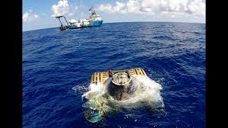
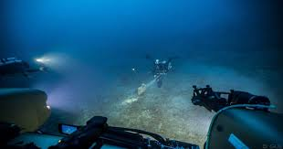
“This was based on the extensive surveys carried out by the scientists of CSIR-NIO, on several research ships leading to the allocation of an area of 150,000 sq km to the country with exclusive rights under the UN Law of the sea. Subsequently, environment impact assessment (EIA) studies for nodule mining by CSIR-NIO, development of metal extraction process by CSIR-National Metallurgical Laboratory, Jamshedpur, and CSIR-Institute for Minerals and Metals Technology, Bhubaneswar, and development of mining technology by National Institute of Ocean Technology (NIOT), Chennai, have been taken up under the national program on polymetallic nodules funded by MoES”, said NIO Director VSN Murthy.

Slide 7
OUR ACHIEVEMENTS
Based on the resource evaluation, India has now retained an area of 75,000 sq km with an estimated resource of about 100 million tons of strategic metals such copper, nickel, cobalt besides manganese and iron.
A FGM (First Generation Mine-site) with an area of 18,000 sq km has been identified. Latest technologies for extraction of metals from the minerals have also been developed.

Slide 8
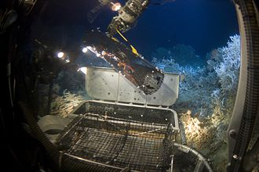
The submersible's manipulator arm collecting a crab trap containing five galatheid crabs. This is an eel trap that has been modified to better catch deep sea fauna. Life on the Edge 2005 Expedition.

Slide 9
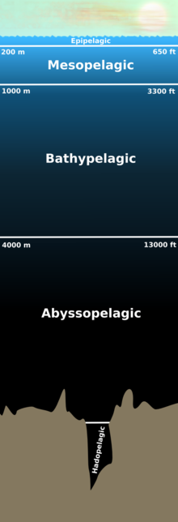
Deep sea zones

Slide 10
Exploration
Describing the operation and use of an autonomous lander (RV Kaharoa) in deep-sea research; the fish seen are the abyssal grenadier (Coryphaenoides armatus).
The deep sea is one of the less explored areas on Earth. Pressures even in the mesopelagic become too great for traditional exploration methods, demanding alternative approaches for deep sea research. Baited camera stations, small manned submersibles and ROVs (remotely operated vehicles) are three methods utilized to explore the.

Slide 11
ocean's depths. Because of the difficulty and cost of exploring this zone, current knowledge is limited. Pressure increases at approximately one atmosphere for every 10 meters meaning that some areas of the deep sea can reach pressures of above 1,000 atmospheres. This not only makes great depths very difficult to reach without mechanical aids, but also provides a significant difficulty when attempting to study any organisms that may live in these areas as their cell chemistry will be adapted to such vast pressures

Slide 12
THANK YOU

