Slide 1

E-VEHICLE POLICY

Slide 2
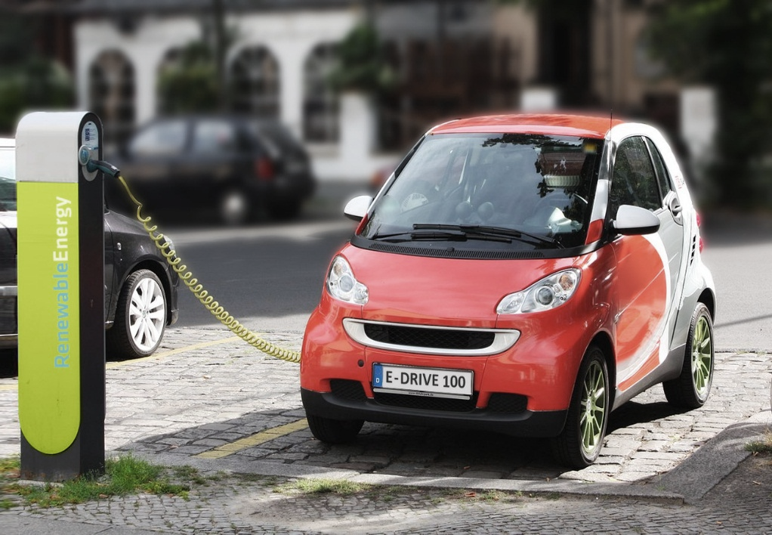
introduction
The Karnataka state government, in its efforts to become the Electric Vehicle Capital Of India, has approved the state’s Electric Vehicle and Energy Storage Policy 2017.
The initiative is in line with the union government’s vision to make the country an all-electric vehicle market by 2031.
An informal group of ministers formed to prepare a draft electric vehicle policy has submitted its suggestions to the cabinet secretary.

Slide 3
E-vehicle policy in India
In INDIA government will be ready with its electric vehicle policy by December.
This policy will cover both light and heavy vehicles like cars and buses.
Many Indian firms are showing interest in investing in electric vehicles and supporting infrastructure.
The first pilot of electric vehicle transportation is ready to be launched in Nagpur the coming week and will set an example for other cities.

Slide 4
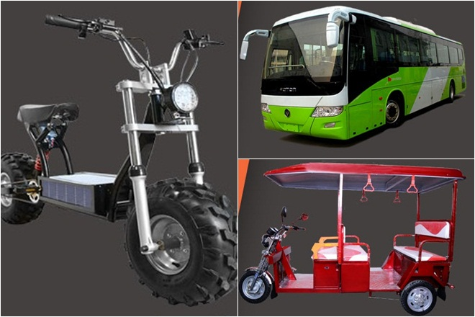
CONDITION OF E-VEHICLE SALES IN INDIA
Electric vehicle sales are low in India.
Sales rose 37.5% to 22,000 units in fiscal 2016 from 16,000 in fiscal 2015;
Only 2,000 of these were cars and other four-wheelers, according to automobile lobby group Society of Indian Automobile Manufacturers.

Slide 5
GOVERNMENT STEPS TOWARDS E-VEHICLE
The government wants to see 6 million electric and hybrid vehicles on the roads by 2020 under the National Electric Mobility Mission Plan 2020 and Faster Adoption and Manufacturing of (Hybrid &) Electric Vehicles in India (FAME India Scheme).
It has been offering subsidies on electric and hybrid vehicles of up to Rs29,000 for bikes and Rs1.38 lakh for cars under FAME India Scheme, but the plan is to make it economically viable on its own.
The prices of the vehicles will be too high so the purchase will be comparatively less.
But our government is trying to make electric vehicles more popular in the state in a reasonable price.

Slide 6
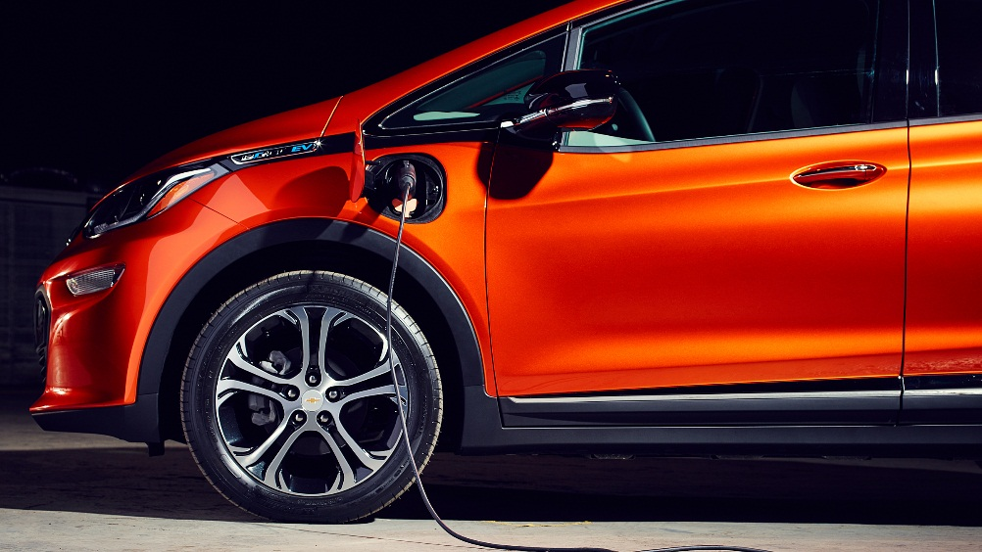
CONCLUSION
With the help of Government and its policy it will be possible to introduce e-vehicle in our state.
This will further benefit humans because with the introduction of e-vehicles air pollution will obviously reduce.
In future we will see a better environment to live for
Here are some of the hybrid cars available in India now: Toyota Prius, Toyota Camry Hybrid, BMW i8.,Mahindra Scorpio MicroHybrid.

Slide 7


