Slide 1
Plug-in Electric Vehicle Policy
A Brief study

Slide 2
The state cabinet on Wednesday [13.09.2017] approved the Karnataka Electric
Vehicle & Energy Storage policy, and became the first to have such a policy
in place.
The policy aims to promote research & development in electric mobility
and grow the sector.

Slide 3
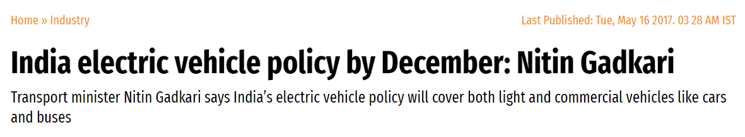
Previously it was being anticipated that E-Vehicles Policy would come
To India by the end of the year, but it seemed to have arrived a bit too soon.

Slide 4
What is an E-Vehicle?
An electric car is powered by an electric motor instead of a gasoline engine.
The electric motor gets energy from a controller, which regulates the amount of
power—based on the driver’s use of an accelerator pedal. The electric car
(also known as electric vehicle or EV) uses energy stored in its rechargeable batteries,
which are recharged by common household electricity.
Unlike a hybrid car—which is fueled by gasoline and uses a battery and motor to
improve efficiency—an electric car is powered exclusively by electricity. Historically,
EVs have not been widely adopted because of limited driving range before needing
to be recharged, long recharging times, and a lack of commitment by automakers to
produce and market electric cars that have all the creature comforts of gas-powered
cars. That has changed. As battery technology improved—simultaneously increasing
energy storage and reducing cost—major automakers introduced a new generation
of electric cars.

Slide 5
Why E-Vehicles?
Electric cars produce no tailpipe emissions, reduce our dependency on oil,
and are cheaper to operate. Of course, the process of producing the electricity moves
the emissions further upstream to the utility company’s smokestack—but even dirty
electricity used in electric cars usually reduces our collective carbon footprint.
Another factor is convenience: In one trip to the gas station, you can pump 330 kilowatt-hours
of energy into a tank commonly holding 10 or more gallons. It would take several days to get
the same amount of energy from household electric current. Fortunately, it takes hours and
not days to recharge an electric car, because it's much more efficient. Speaking of convenience,
let's not forget two important points: charging up at home means never going to a gas station—and
electric cars require almost none of the maintenance, like oil changes and emissions checks,
that internal combustion cars require.
Electric motors develop their highest torque from zero rpms—meaning fast (and silent)
zero-to-60 acceleration times.

Slide 6
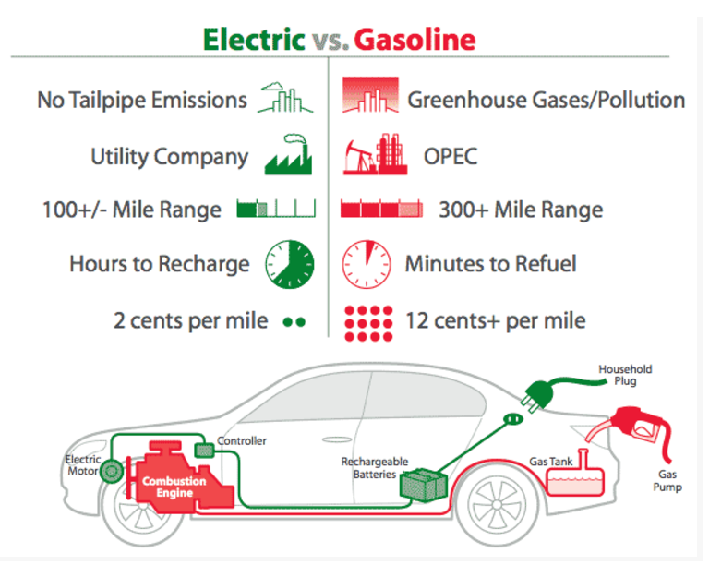
In the illustration, we show the relative features of electric cars and gas-powered
cars. However, it doesn't have to be an "either-or" situation. Plug-in hybrids offer many
of the benefits of electric cars while mitigating most of the drawbacks, such as limited
driving range.

Slide 7
Key Takeaways From Karnataka Electric Vehicle And
Electric Storage Policy
The Karnataka government effort to launch Electric Vehicle and Energy
Storage Policy 2017 aims to
i. Reduce dependency on fossil fuels, and bring down pollution levels.
ii. Attract investments worth $4.83 Bn (INR 31K Cr) and create around 55,000 employment
opportunities.
iii. Set up new EV manufacturing zones, as well as set up charging stations in public and
private spaces including airports, railway stations, metro stations, highrise buildings, malls, information
technology (IT) parks, and apartment complexes
iv. Encourage startups to develop business models focused on supporting economic applications
for EVs.
v. Create special purpose vehicle that will involve civic agencies, state transport and energy
companies, and its renewable energy and industrial boards for the creation of charging infrastructure
within the state.

Slide 8
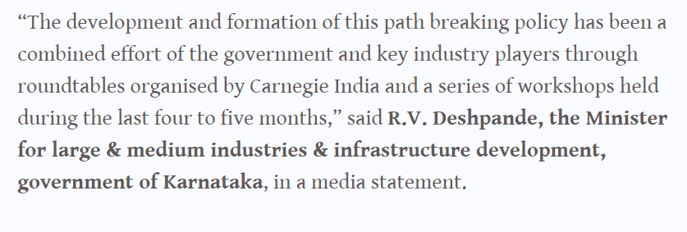
He also added, “I am sure this policy would be a game-changer in the industry and
will be a model for other states. Our real work starts now, focusing on developing a ready
ecosystem for a vibrant EV sector in the state,” said R V Deshpande, Karnataka’s industries minister.

Slide 9
Now we will have to wait for the upcoming future and see how good this
Policy pans out to be, and also how commercial success E-vehicles get in the Indian Market.
THE END
-A presentation by Prince.

